Slide 1
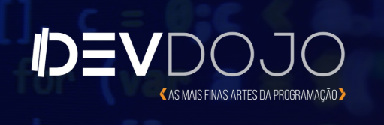

Back-testing and machine learning models bruno.abia@icomp.ufam.edu.br twitter: @brunoabia

Slide 2


Salut!
Je m’appelle Bruno Ábia
Ingénieur informatique
Maîtrise en informatique
Conseiller chez CGI
Youtuber - DevDojo Academy

Slide 3
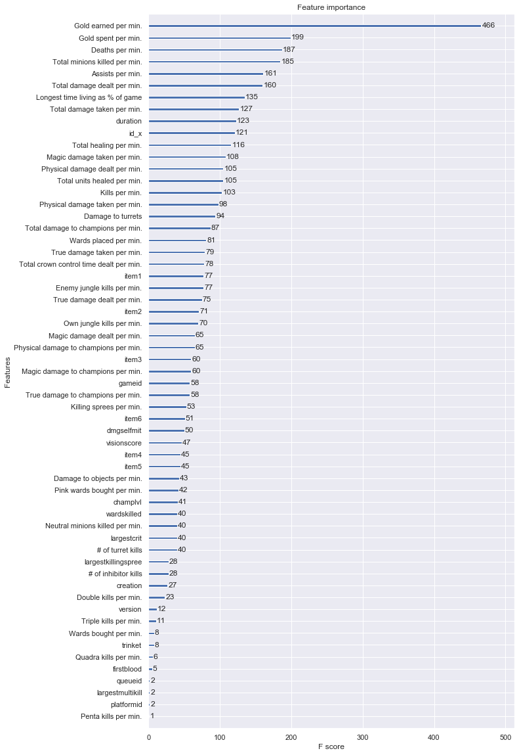
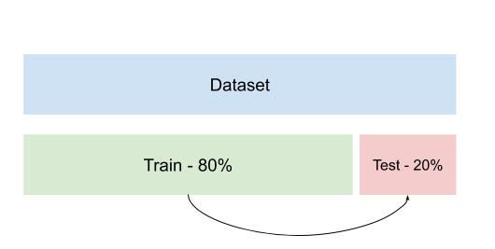

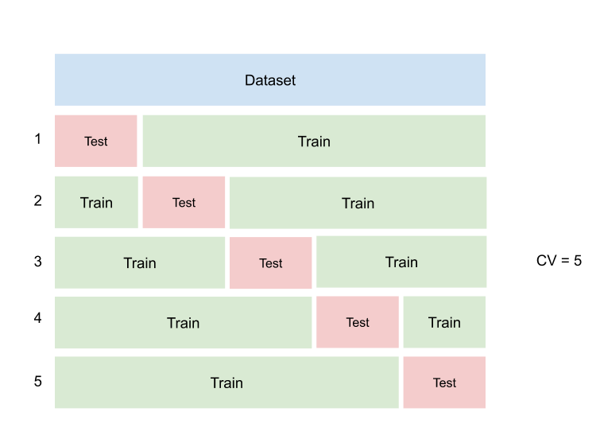
Why is important to study about it?
When we start to study data science is common to begin with traditional methods to understand and evaluate our machine learning models. For example:

Slide 4
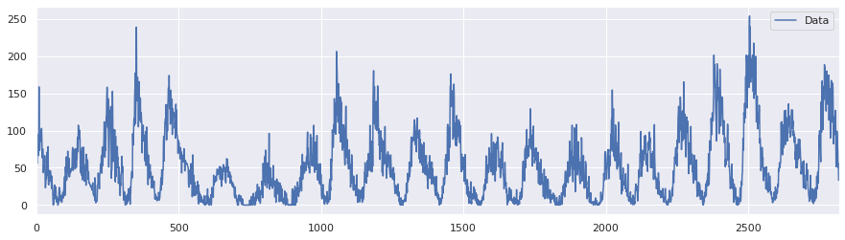
What is back-testing?
The back-testing is a technique to evaluate the machine learning models when you want to consider temporal components.

Slide 5
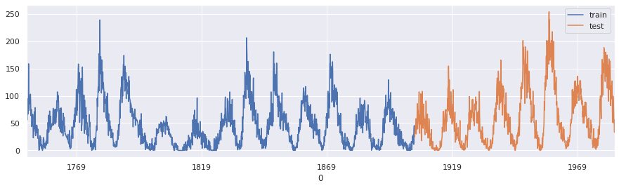
Where I can use back-testing?
You can use Back-testing in ANY machine learning problem that you have temporal components. For example, if you work with sentiment analysis with social network data, you can consider collected date as component.

Slide 6

How I can apply back-testing?

Slide 7
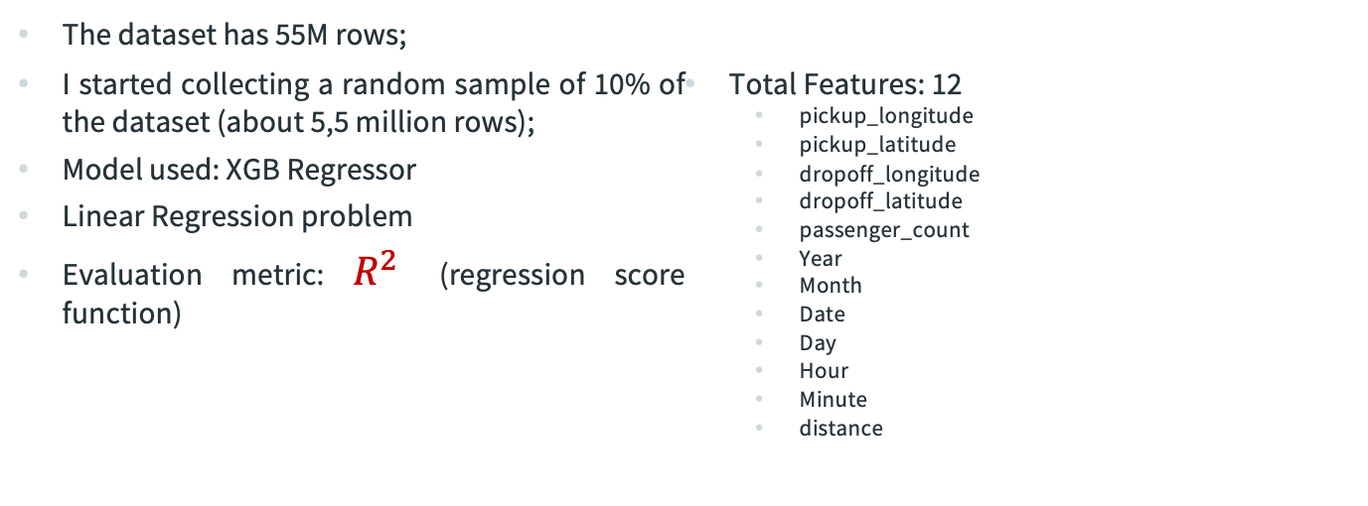
Example: New York Taxi Fare Prediction Problem
The dataset has 55M rows;
I started collecting a random sample of 10% of the dataset (about 5,5 million rows);
Model used: XGB Regressor
Linear Regression problem
Evaluation metric: $R^{2}$ (regression score function)
Total Features: 12
pickup_longitude
pickup_latitude
dropoff_longitude
dropoff_latitude
passenger_count
Year
Month
Date
Day
Hour
Minute
distance

Slide 8
Example: New York Taxi Fare Prediction Problem
To create the tests, I used the years as a temporal component

Slide 9
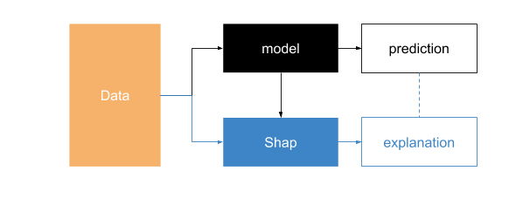
Explanation with Shap Valeus
SHAP (SHapley Additive exPlanations) is a unified approach to explain the output of any machine learning model. SHAP connects game theory with local explanations, uniting several previous methods.

Slide 10
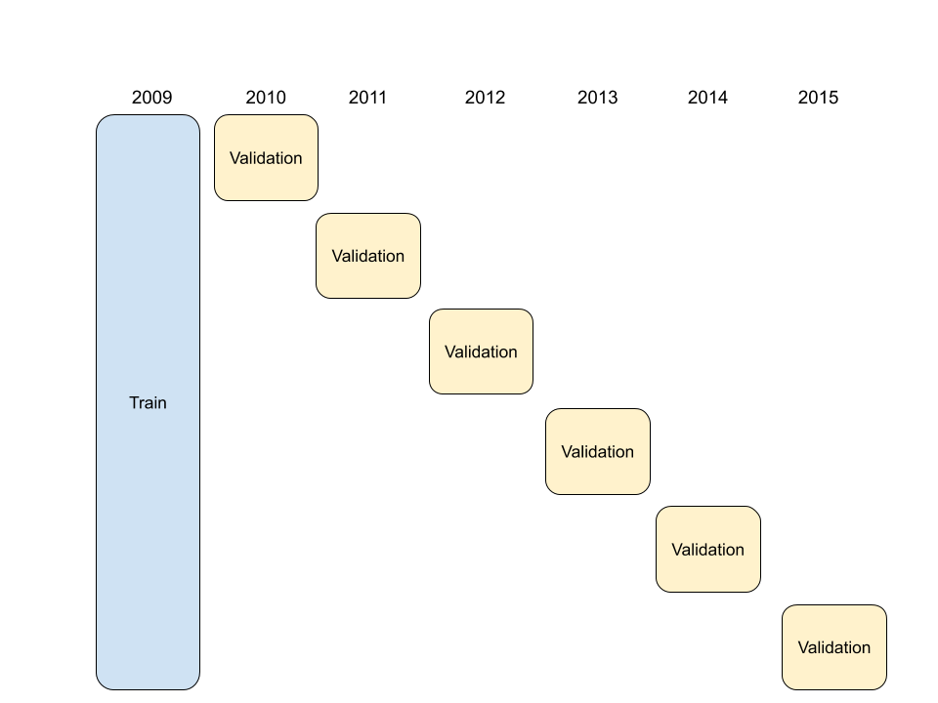
Walk-forward - Static
This approach suggests static training model of data, and making predictions for the following period.

Slide 11
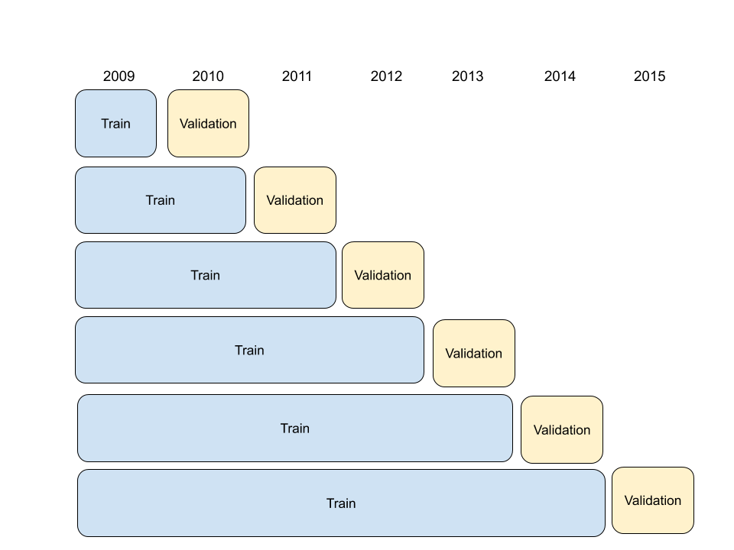
Walk-forward - Dynamic
This approach suggests training models on successive (potentially sliding) windows of data, and making predictions for the following period.

Slide 12
Example: New York Taxi Fare Prediction Problem
For each step, you can combine the traditional techniques to help you to understand the results:
Estimating the Hyperparameters
Calculating the important features
Applying Shap Values
Static
Dynamic

Slide 13
Example: New York Taxi Fare Prediction Problem
It observed with back-testing the samples of 2010 are not “important” for model prediction. If we train the model without 2010. The result is:
0.86
0.81

Slide 14
We can do too..
Applying back-testing with hours as a temporal component.

Slide 15
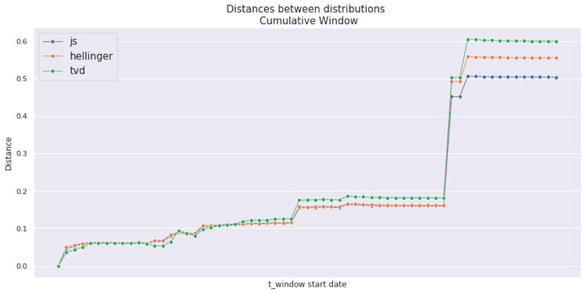
The Concept Drift
The Concept Drift means that the statistical properties of the target variable, which the model is trying to predict, change over time in unforeseen way.
I want to identify a big change behavior in our system. When I found, I come back to data study and back-testing.

Slide 16
Conclusion
Back-testing allows us to understand our data;
We can select the best model based on temporal components;
The training process is long, but the results are cool = ) ;
Shap Values allows us to see the important features;

Slide 17
References
Thais Almeida, Bruno Ábia, Eduardo Nakamura, Fabíola Nakamura (2017, October). Detecting hate, offensive, and regular speech in short comments. In Proceedings of the 23rd Brazillian Symposium on Multimedia and the Web (pp. 225-228).
Shapley sampling values: Strumbelj, Erik, and Igor Kononenko. "Explaining prediction models and individual predictions with feature contributions." Knowledge and information systems 41.3 (2014): 647-665.
LIME: Ribeiro, Marco Tulio, Sameer Singh, and Carlos Guestrin. "Why should i trust you?: Explaining the predictions of any classifier." Proceedings of the 22nd ACM SIGKDD International Conference on Knowledge Discovery and Data Mining. ACM, 2016.
Shap Values: https://github.com/slundberg/shap
Back-testing: https://machinelearningmastery.com/backtest-machine-learning-models-time-series-forecasting/
Dataset: https://www.kaggle.com/c/new-york-city-taxi-fare-prediction/overview

Slide 18
Merci Beaucoup!
Any questions?
You can find me at:
Twiiter: @brunoabia & bruno.abia@icomp.ufam.edu.br

